Slide 1
Machine learning
Chris Geggis
1/19/2023

Slide 2
Welcome to the university of Machine Learning (UML)
Class recording will commence, in T-minus 10, 9, 8…

Slide 3
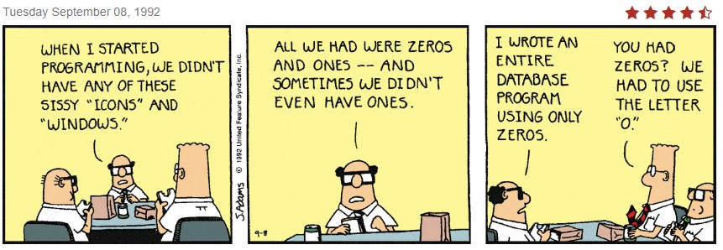
Attendence
Credit: Scott Adams

Slide 4
Syllabus
On Screen
Blackboard (Maybe this will work?)

Slide 5
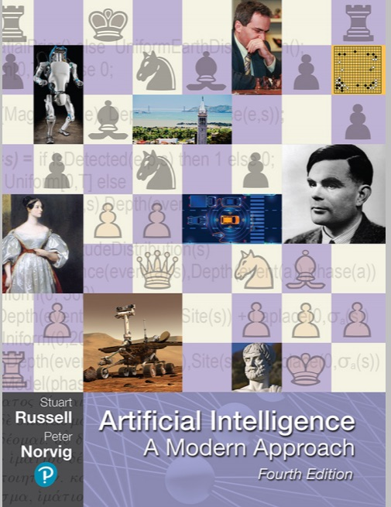
Required Book (Cover)
Warning on International edition
(Chapters are different)
Also warn on 2 device limit
$56 to rent hardcover
$171 to buy hardcover
$75 for Kindle Edition

Slide 6
UML Library
UML Library Databases
Introducing Python, 2nd Ed, by Bill Lubanovic (2019)
Machine Learning with Python Cookbook, 2nd Ed, by Kyle Gallatin and Chris Albon (2023)
AI and Machine Learning for Coders, by Laurence Moroney (2020)
Intro to Machine Learning with Python, by Andreas C. Müller and Sarah Guido (2016)
Designing Machine Learning Systems, by Chip Huyen (2022)

Slide 7
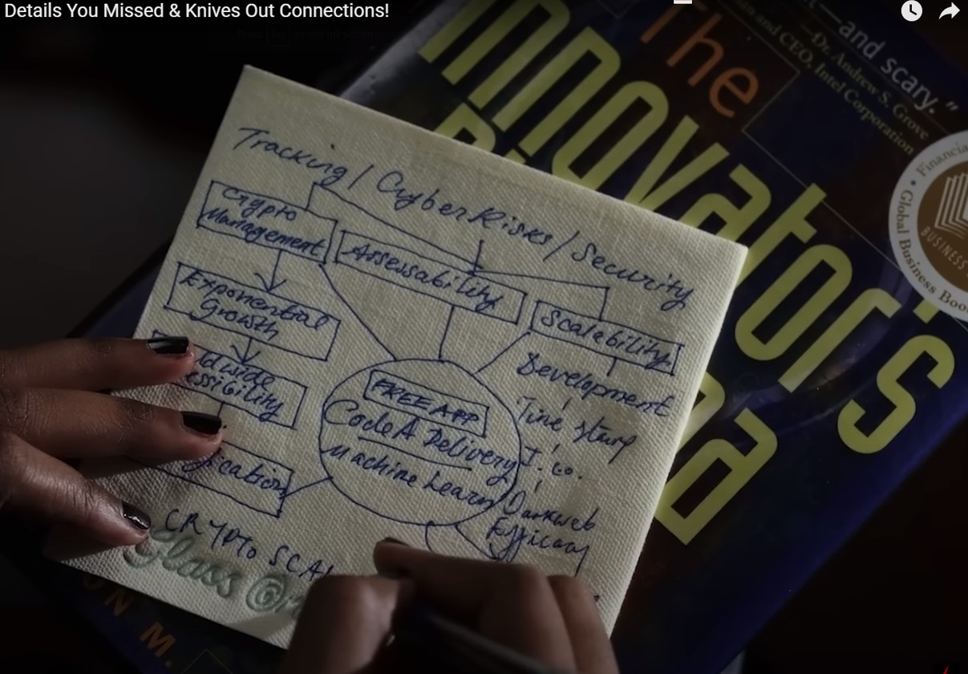

Slide 8
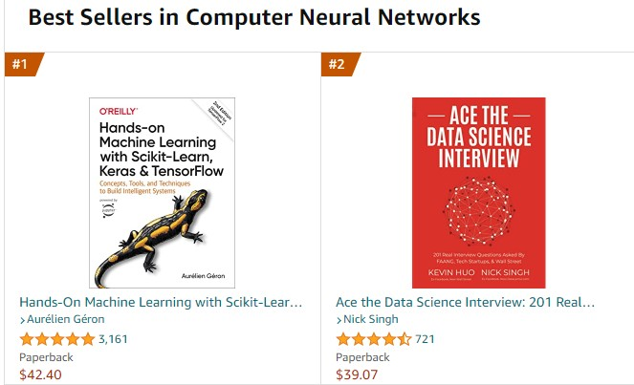
Best sellers

Slide 9
The downsides of a career in ML
ML is somewhat difficult
Lots of turnover
Once a desired model is created, the creator may be expendable

Slide 10
Python libraries
numpy (fast linear algebra, [arguably] most important library)
tensorflow
scikit-learn
pytorch
pandas
keras

Slide 11
Sites
Why Neural Networks can learn (almost) anything (10.5 min YouTube)
Tensor Flow Playground
ChatGPT

Slide 12
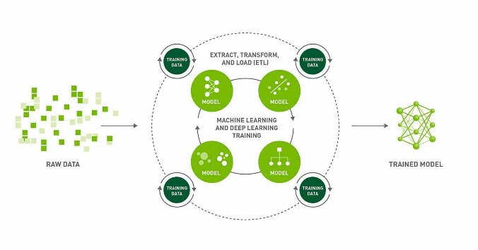
Extract, transform, and Load (ETL)

Slide 13
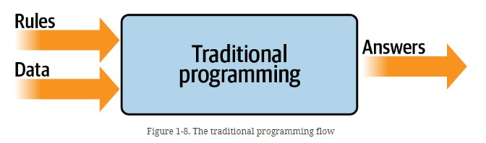
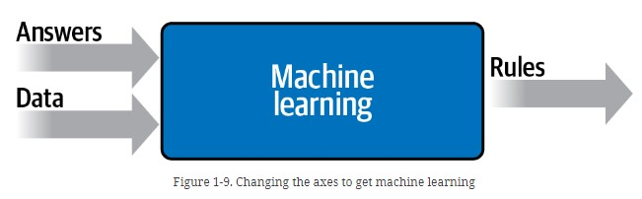
Traditional programing AND Machine learning

Slide 14
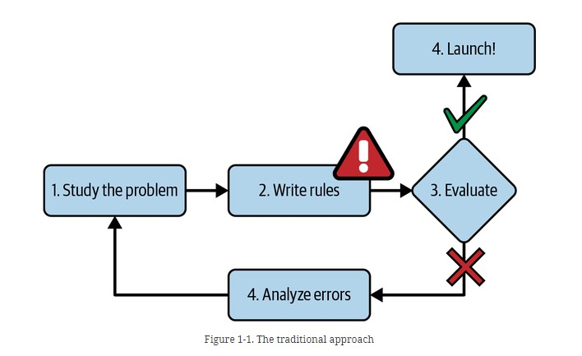
Traditional Approach

Slide 15
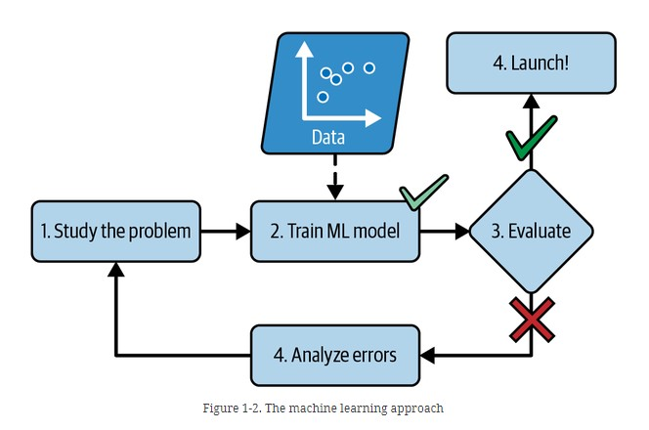
ML Approach

Slide 16
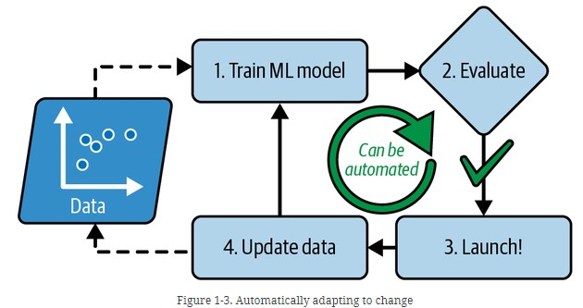
Automated ML approach

Slide 17
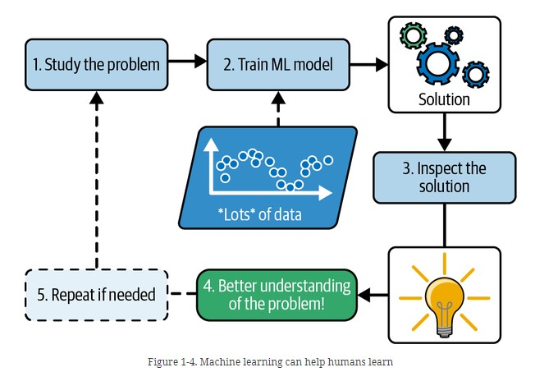
ML Helping Humans

Slide 18
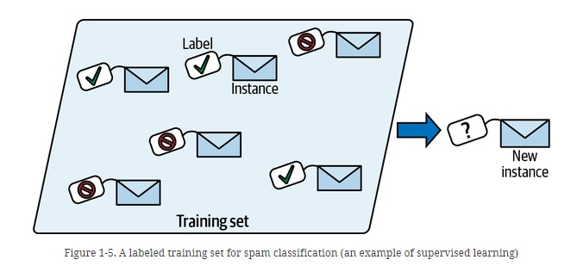
Training set with labels

Slide 19
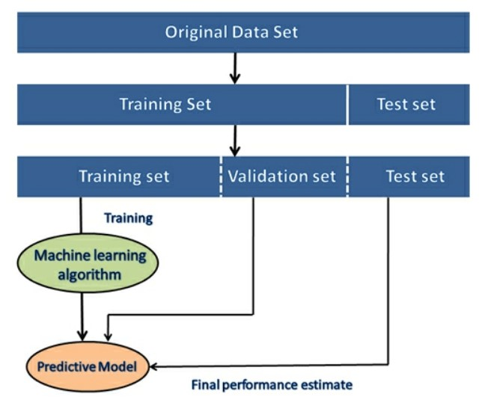
Supervised learning

Slide 20
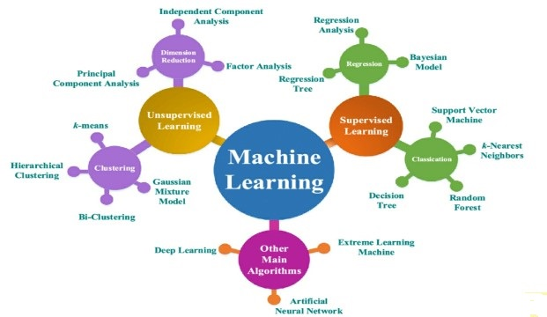
MAP of ML

Slide 21
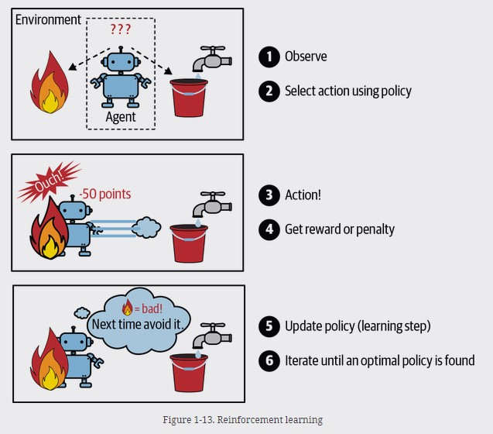
Reinforcement learning

Slide 22
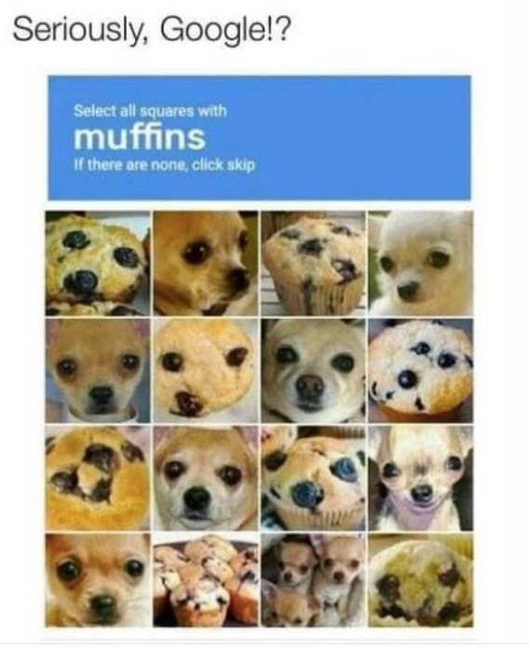
Credit: Unknown

Slide 23
If the product is free…
You are (most likely) the product
Google (and Amazon)
Facebook
LinkedIn
DuoLingo (Supervised)
Pintrest (Clustering)
Twitter

Slide 24
Degrees & Certificates
BS Applied Physics: Optics Concentration, Math Minor: Computer Option ‘93
Certificate in UNIX ‘94
MS Computer Science ‘03
Certificate in Database ‘05
Completed all core courses for MBA (+ a few electives) at Babson (+ a couple of classes at Northeastern) – no degree finished in ‘12

Slide 25
(kurt) Gödel’s Incompleteness Theorem
No human knows everything
Machines will (probably) never know everything

Slide 26
If 5:30 PM or earlier
3Blue1Brown Neural Networks, Part 1

